Slide 1

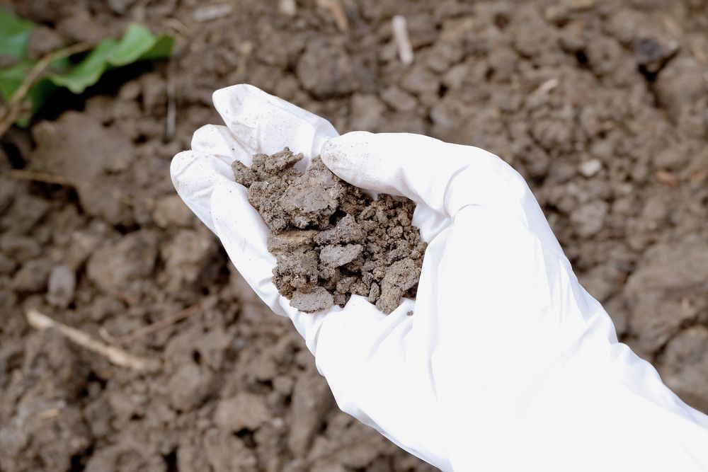




WG 7: Contaminants of emerging concern in soil and the terrestrial environment
Meeting 6th of September 2024
Annegret Biegel-Engler (UBA) and Laetitia Six (OVAM)
Annegret.Biegel-Engler@uba.de Laetitia.six@ovam.be

Slide 2

Why this meeting?
Prepare the WG7 project propasal for JPA 2025
Agenda:
Recap of last meeting
Feedback JRC workshop “Soil Pollution and Remediation: Data and Knowledge Structuring, Harmonizing and Sharing” 30-07-2024, ISPRA
Defining the project
  Project aims
  Expected deliverables
  Timing
  Budget
  Working groups

Slide 3
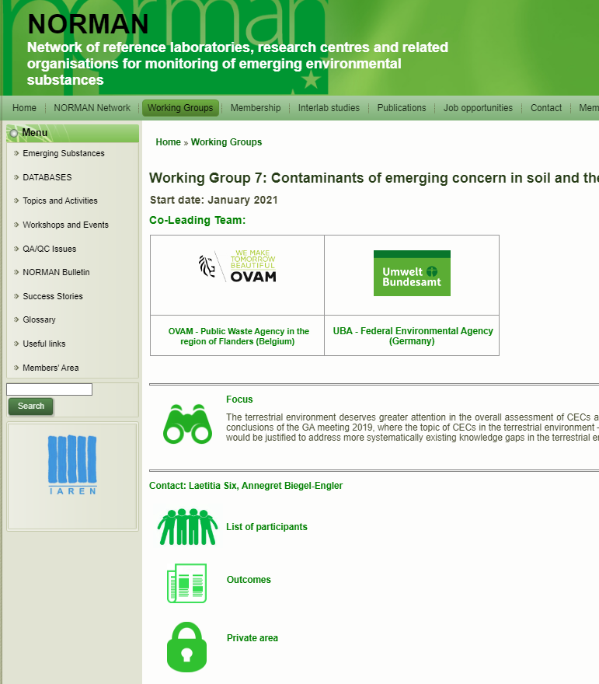
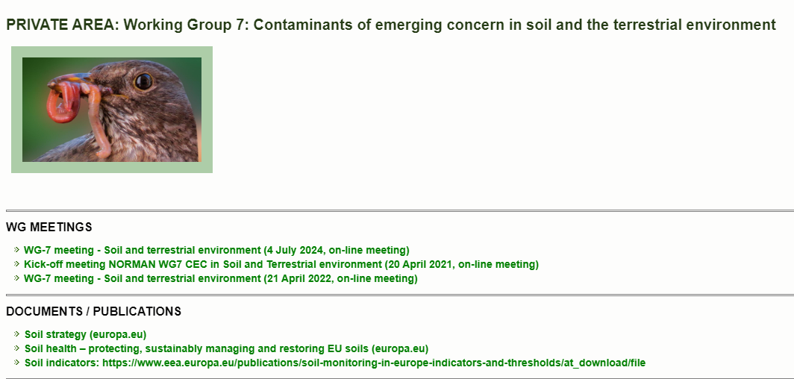
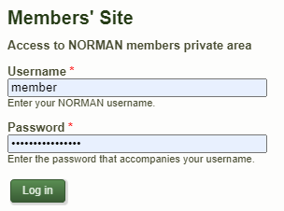
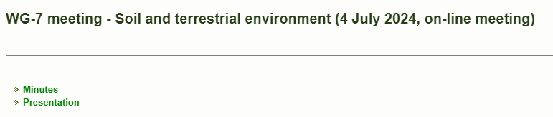
Recap of last meeting – finding documents

Slide 4
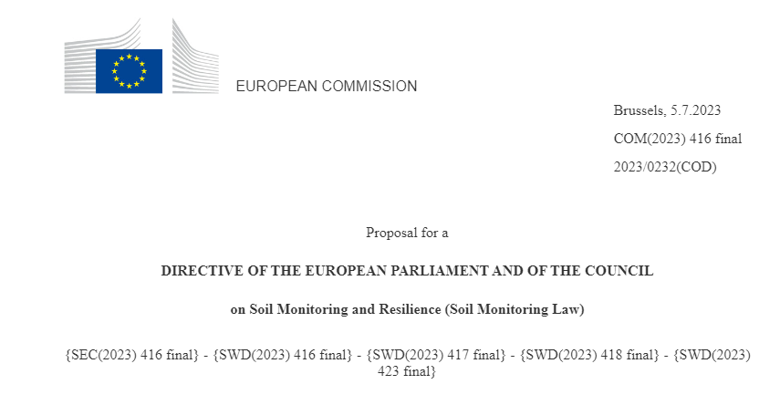
Recap of last meeting
Discussion on project ideas
  Priority substances for EU Soil Monitoring Law (SML)
  Improving PFAS analytics: TOPA, sum PFAS guidance, comparison NTA and precursor analysis
Priority substances SML
  Significant interest by participants
  Setting out a framework for the selection of Priority Substances
  Match to the needs of Member States authorities ➔ soil watch list
  Yet also projecting which (emerging) contaminants should be monitored in the future incl. use of novel methods ➔ future-proof soil watch list

Slide 5

Feedback JRC workshop
“Soil Pollution and Remediation: Data and Knowledge Structuring, Harmonizing and Sharing” 30-07-2024, ISPRA
(Xenia Trier, Aragorn project)

Slide 6

Project: Development of a “soil watch list”

Slide 7
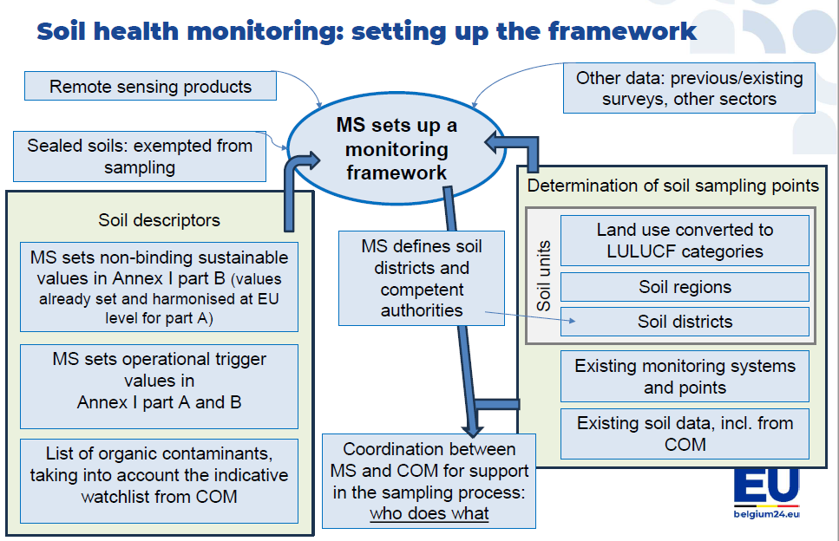
Priority substances for EU SML
Input of the Council to the EU SML (up for discussion trialogues):
A watch list, as in use in the Water Framework Directive (WFD) for surface and groundwater, should be developed for soil contamination.
The Commission, in cooperation with the Member States, shall establish an indicative watch list of soil contaminants, having a high potential to affect soil health, human health or the environment. The watch list should be updated according to the latest scientific knowledge. Member States may then adapt their soil contamination descriptor accordingly.
Setting up a monitoring framework to assess the soil health and follow the evolution of soil health and to identify degraded soils in order to regenerate soils and contribute to the 2050 objective
Annex I, Part B:
Soil descriptors with criteria for healthy soil condition established at MS level
Soil contamination:
Concentration of heavy metals in soil (As, Sb, Cd, Co, Cr total, Cu, Hg, Pb, Ni, Tl, V, Zn)
Concentration of a selection of organic contaminants established by the Member States and taking into account existing concentration limits e.g. water quality and air emissions in EU legislation

Slide 8
Defining the aims of the project
Different approaches possible
From a Member State authority perspective in charge of developing a monitoring network
  What is being measured already in MS? Available data?
  Analytical methods, feasibility and costs?
  Justification for prioritisation?
  Related land uses?
From a scientific perspective, incl. innovative methods for analysis

Slide 9
Deliverables and timings
Milestones for the EU COM:
July 2023: EU COM proposal Soil Monitoring Law (SML)
April 2024: EU Parliament adopts its position
June 2024: EU Council agreed and approved general approach towards the EU SML
Upcoming: trilogue negotiations
??: implementation
Urgent action needed
Milestones for WG7:
December 2024: JPA proposal ready
January 2024: official start project
December 2024: Soil watch list ready for transfer to EU COM
Beyond 2024: continue working on future-proof soil watch list?

Slide 10

Call: Volunteers for project writing?

Slide 11
Next steps?
Define dedicated project writing group
Project writing → draft proposal to group by 3-4 December
Soil week in Bxl – contribution? (via Xenia)
GA meeting in Rome 3-4 December (4th until lunch time)
  Need for a back-to-back meeting?
  Propose to host a World Cafe session? Or a seperate session for discussion? → Valeria agenda
  Other ideas? Get view of ongoing soil project via short presentations- look for connections
Finalisation of project proposal based on feedback GA
Project start upon approval
  Work according to defined WGs – volunteers needed!!
Online and live workshops (budget for travel to be imbedded in the JPA proposal)
  Kick-off meeting beginning 2025?

