Slide 1
2024 Norman network
Updates on the
EU Soil Monitoring and Resilience Law
Friday September 6th 2024, Online
Xenia Trier, Associate Professor in analytical environmental chemistry, PLEN, University of Copenhagen
Danish PFAS Task Force– ARAGORN project coordinator

Slide 2
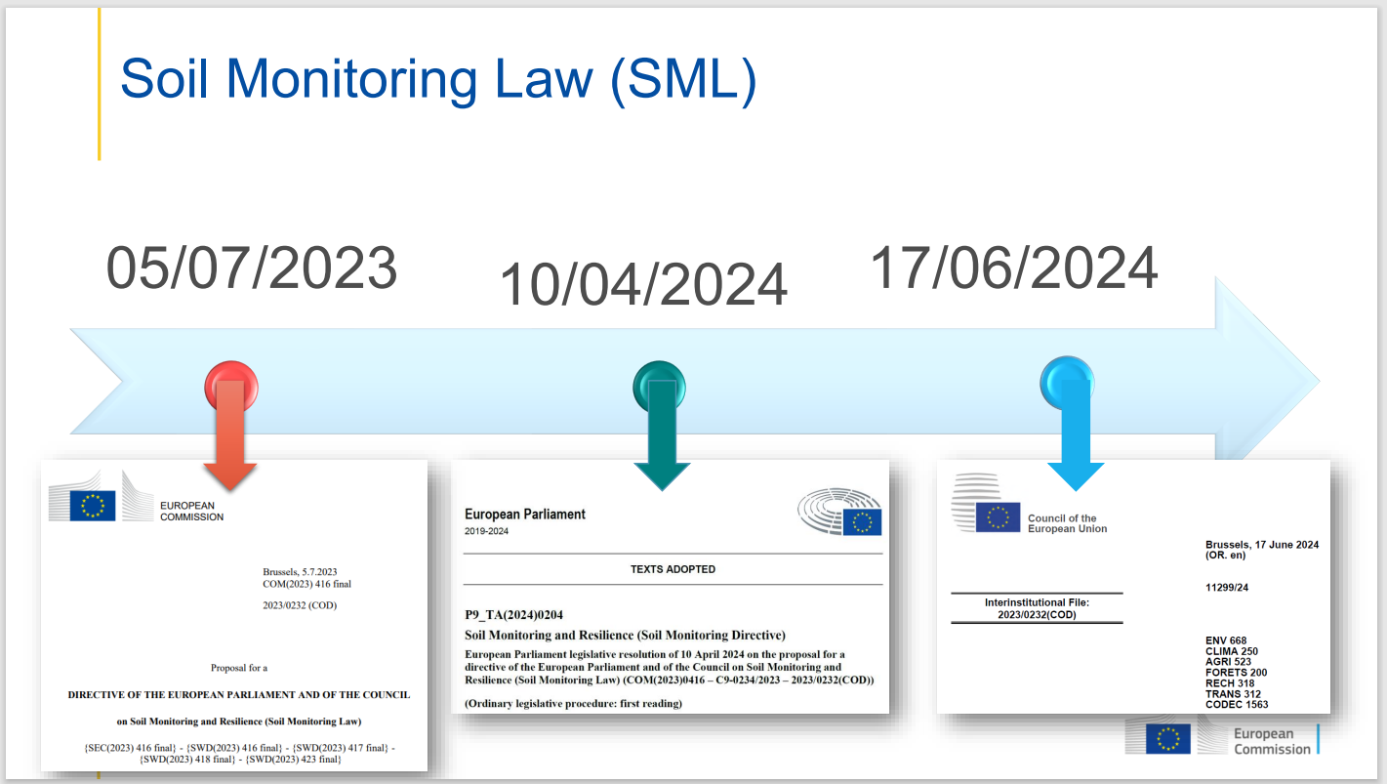
EUs ‘Soil Monitoring and Resilience Law’ – i sin skabelsesfase

Slide 3
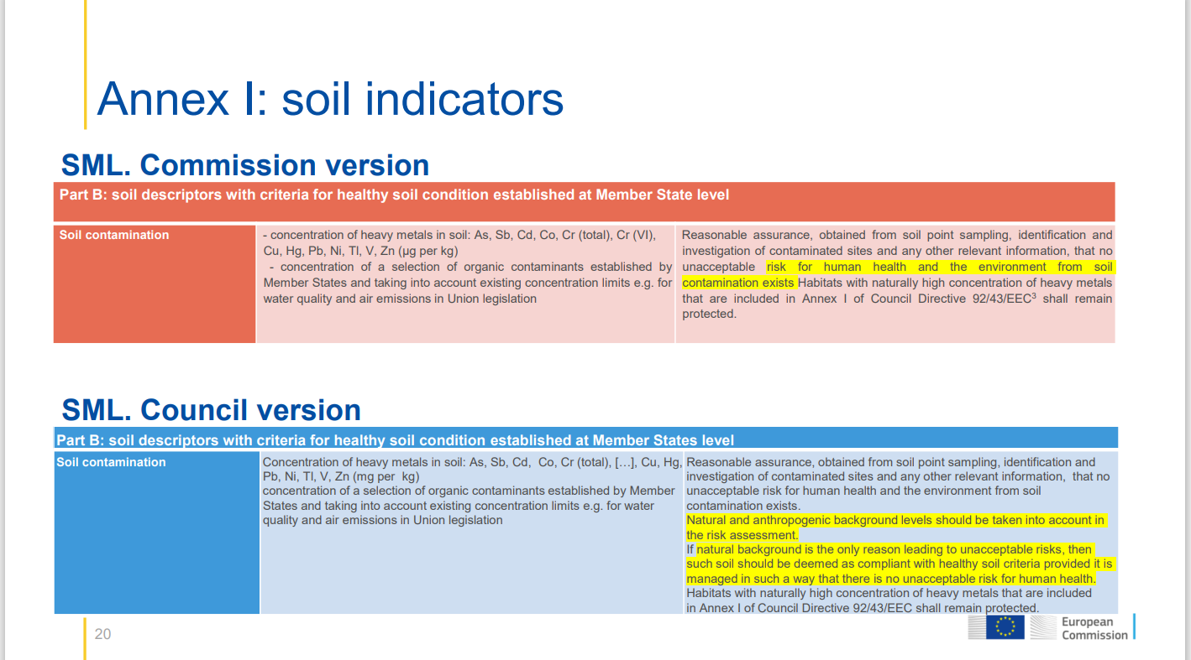
EUs ‘Soil Monitoring and Resilience Law’ – i sin skabelsesfase

Slide 4
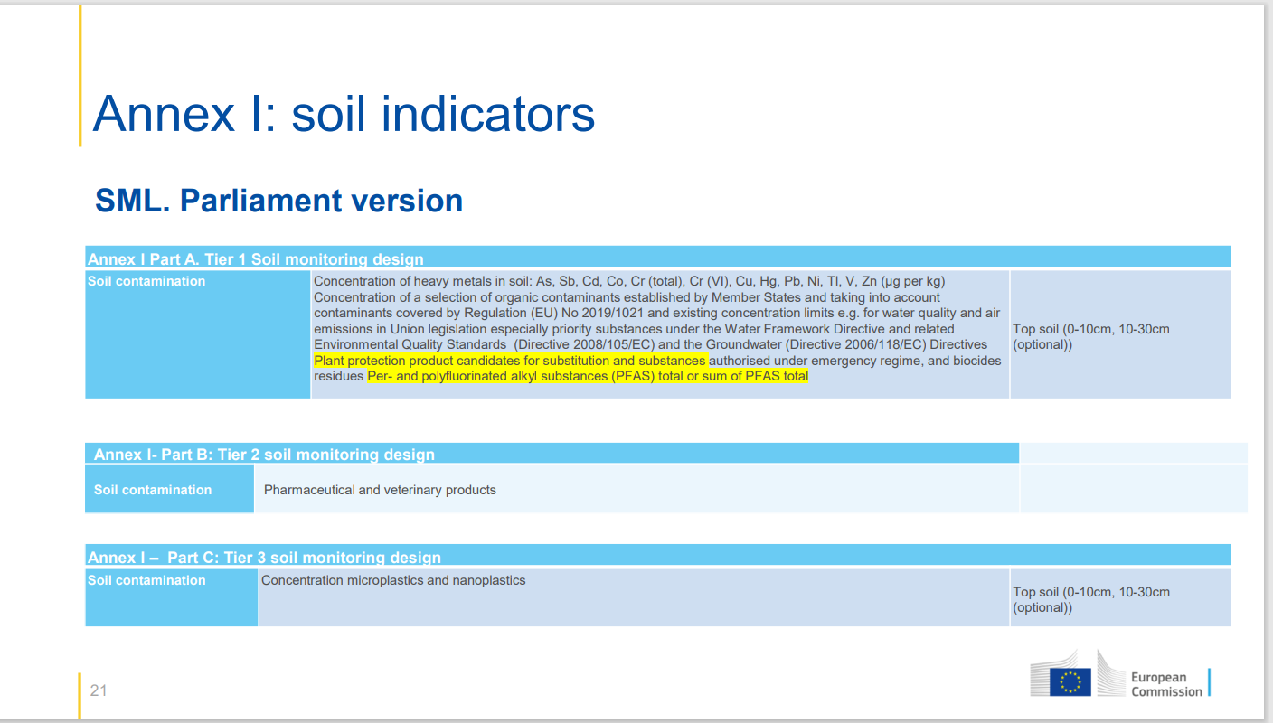
EUs ‘Soil Monitoring and Resilience Law’ – i sin skabelsesfase

Slide 5
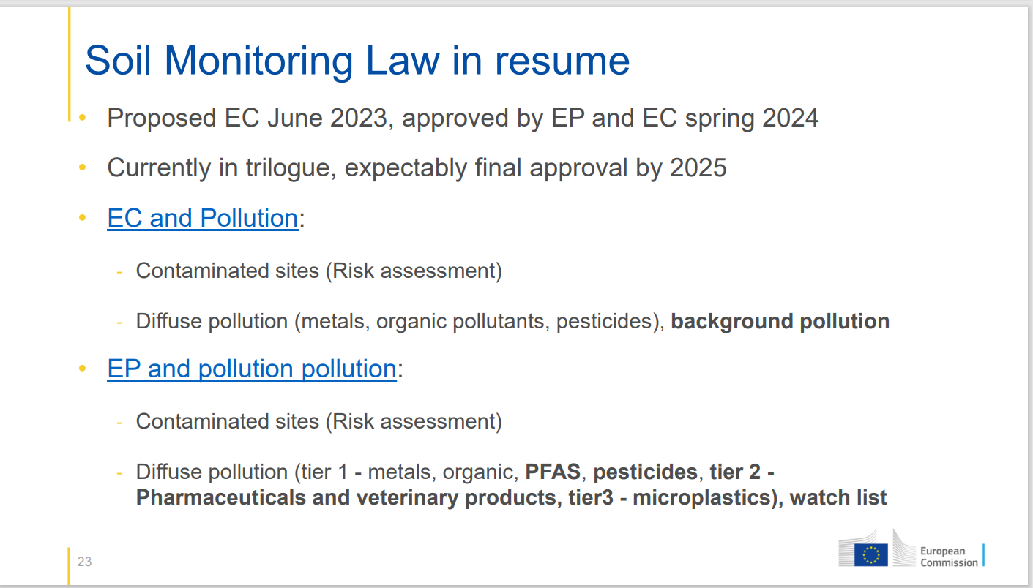
EUs ‘Soil Monitoring and Resilience Law’ – i sin skabelsesfase

Slide 6
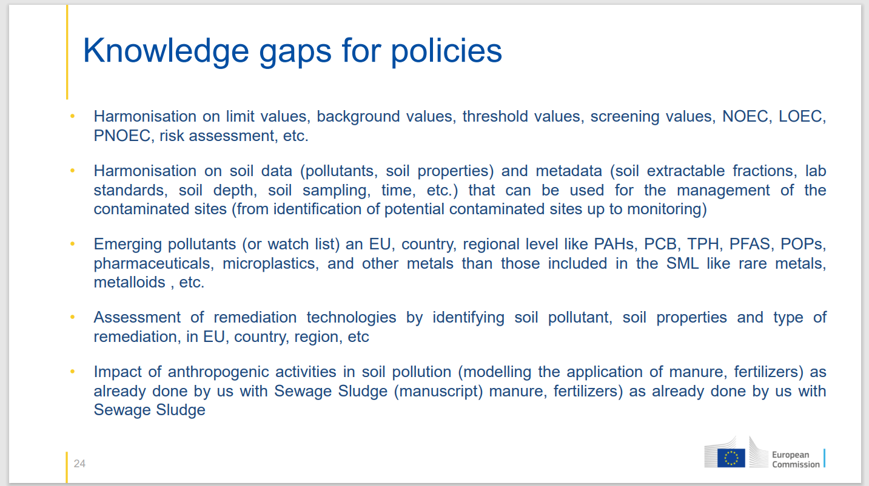
EUs ‘Soil Monitoring and Resilience Law’ – i sin skabelsesfase
c

Slide 7

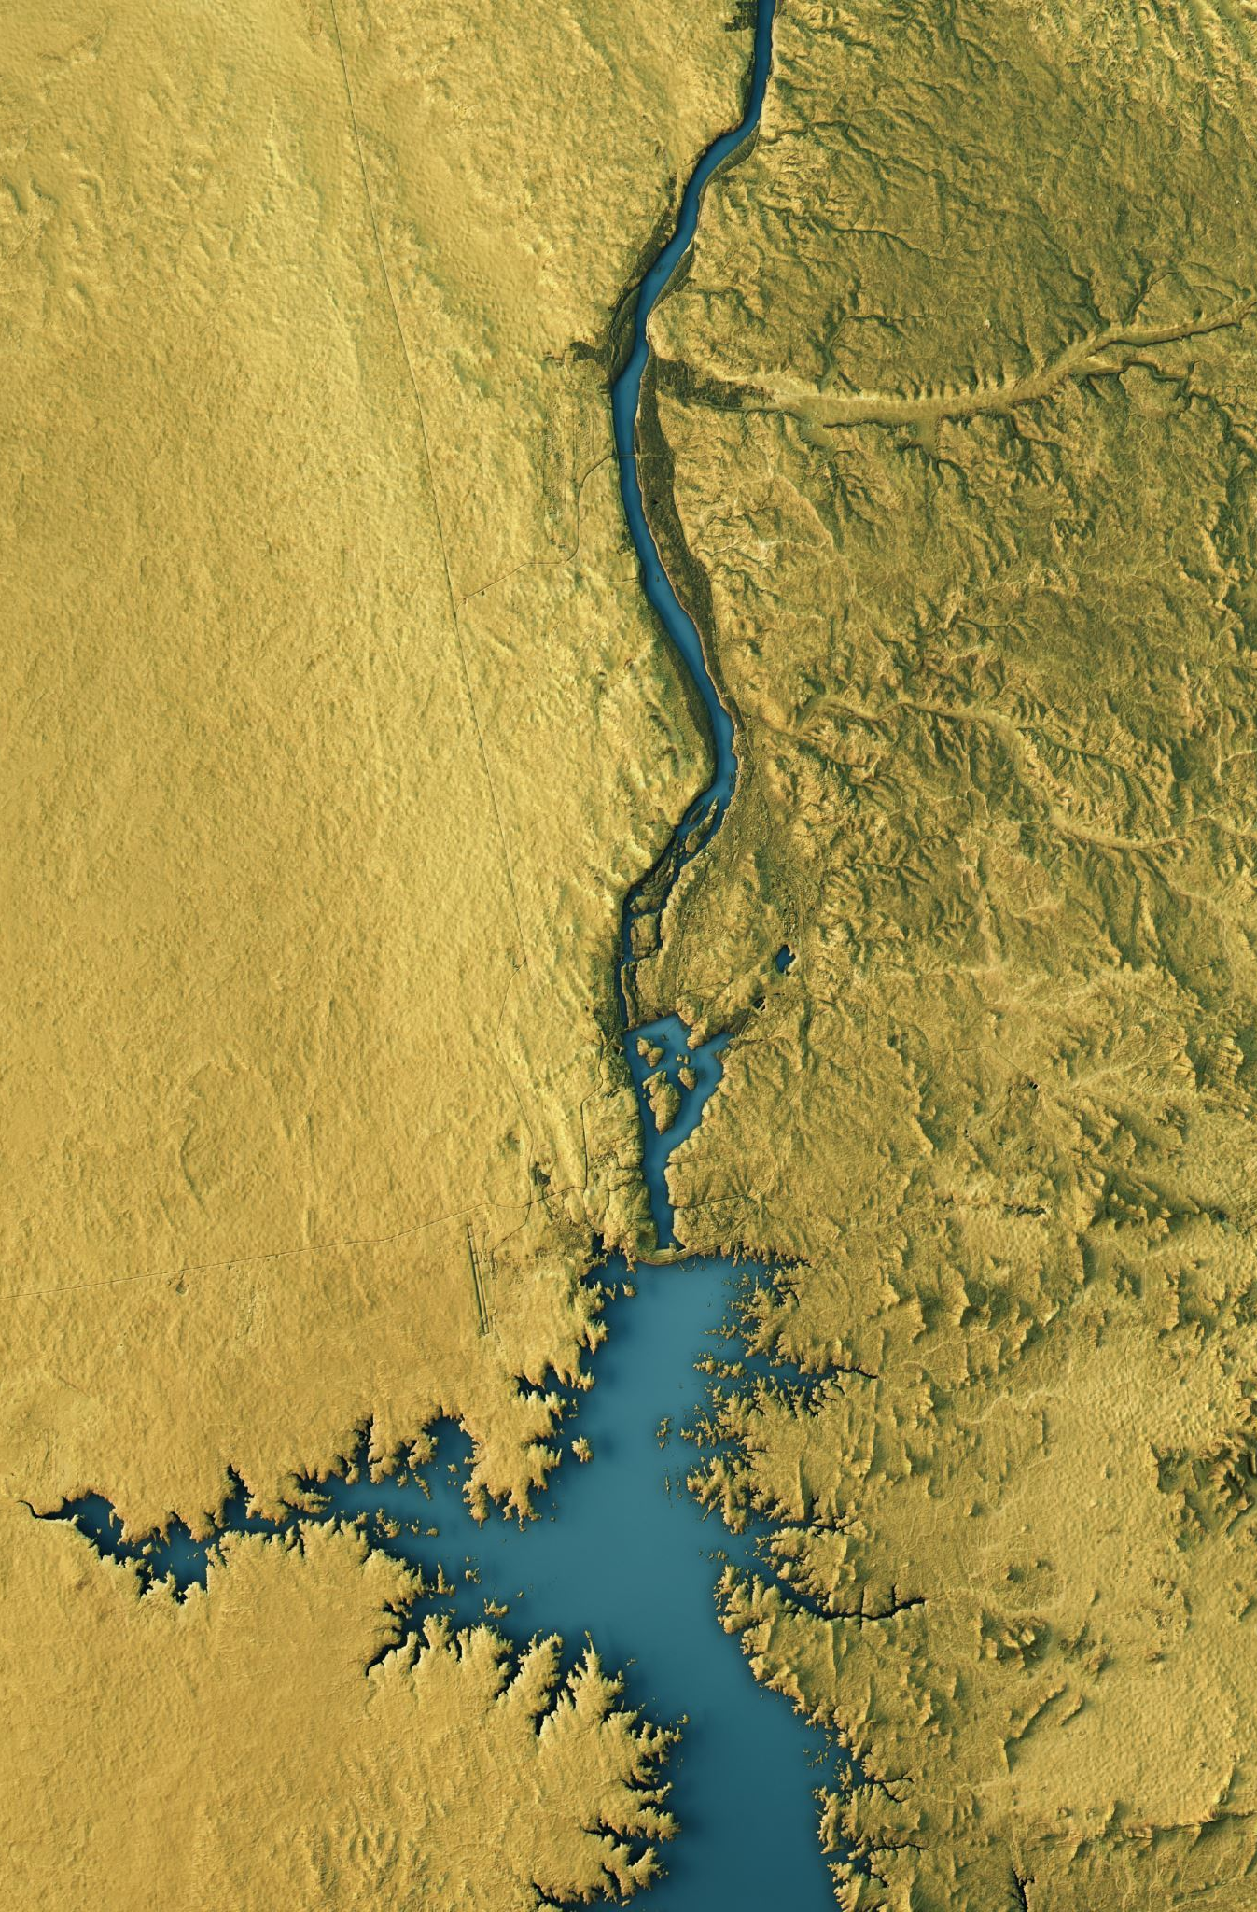
objectives
To support the Soil Mission Aims: Reduce hot-spot soil pollution and enhance restoration in urban, peri-urban and rural environments across Europe – while enabling other EGD objectives of biodiversity, climate, CE. Focus on persistent pollutants and support landowners decision-making.
to collect, monitor, test remediation/restoration and share data
  map potentially and known contaminated sites,
  gather information on sampling, methods, remediation, RA/SEA, co-creation,
  optimise chemical monitoring methods/monitoring strategies to be fit-for-purpose for commercial laboratories and landowners decision-making
  test remediation technologies: From regrettable->restorative remediation
  provide tools and technical guidance documents to support decision-making
  Support the development of the Soil Monitoring and resilience law
to enable land managers in Europe to manage soil pollution by
  Prioritization, planning and co-creation with local community and authorities
  informed decisions on actions to remediate/restore polluted lands
  invest in activities to remediate and restore land
Aragorn Horizon - combat soil contamination in Europe (aragorn-horizon.eu)
PFAS : (Per- and Polyfluorinated Substances)
OCBs: (Organochlorines and Organobromines)
PETCO; (Petroleum and Coal Compounds)
Metals: (Hazardous Metals)

Slide 8
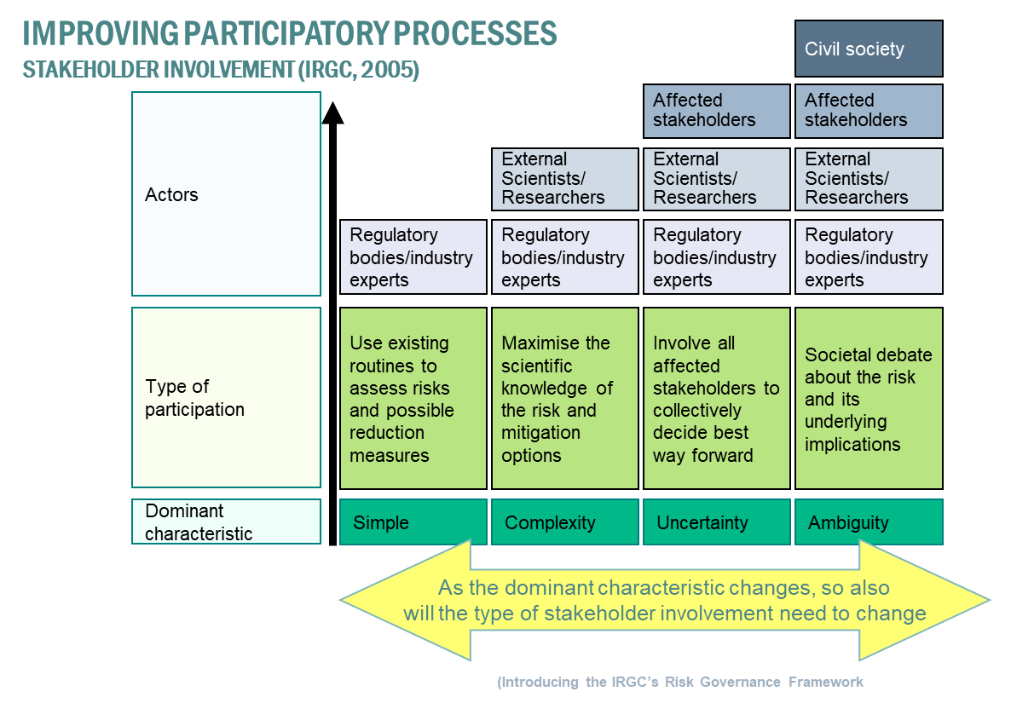
Credit: Dietmar Müller-Grabherr, Austrian UBA
Lead of Common Forum on Soil, ARAGORN Scientific advisor
2nd consortium meeting, Nancy, 2024

Slide 9
Decision minutes
Norman to make minutes.
Stepwise approach; low hanging fruits to more complex; costs!, mechanisms to allow for updates (future proof!)
Norman to make an overview of what WG7 can contribute with, e.g.
  Principles for the SMRL – mechanisms, monitoring strategy etc - Xenia
  Listing of protection goals - Sandrine
  Mapping of land uses, and endpoints (e.g. water, soil intake, prey, sensitive/non-sensitive) – Magnus?
  Mapping of ongoing and past soil pollutant monitoring in countries
  Mapping of regulation of chemicals, which may impact/be impacted by soil pollutants: Sewage sludge, fertilisers, WFD, IED/EPRTR, NEC etc. – Sandrine?
  Mapping of project on soil pollution and impacts etc.
  Mapping of analytical methods, performance and costs - Celia
  Overview of which comtaminants that typically are found
  Data platforms – Valeria (and please send template to Xenia)
Laetitia to establish a TEAMS where we can share information and files
Norman to Set up an online meeting with the group interested
Norman to propose a working task on this for Dec. GA meeting in Rome; and funds for travelling to meet
Xenia to share it with DG JRC/ENV and ask for participation in the Soil Week, Nov 12-13, and cluster meeting on Nov. 14 (Laetitia and Nikoforos/Terrachem might be interested to join)
Xenia to share contacts for the JRC Soil Mission: PEETERS Bavo Bavo.PEETERS@ec.europa.eu , YUNTA MEZQUITA Felipe Felipe.YUNTA-MEZQUITA@ec.europa.eu
Xenia to send deliverables (list of compounds we have prioritised when we have delivered the milestone), so that Norman can continue to work on this, and proposed monitoring strategy incl. NTS

Slide 10

Thanks
Funding:
Danish EPA – PFAS Task Force, etc
DG ENV – DWD PFAS analytical methods
EU Soil Mission – ARAGORN
Global PFAS Science Panel
EU Horizon PARC
Colleagues:
Hans Peter Arp
Anna Kärrman, Eirik Aas,
Peter Mortensen, Søren Dyreborg,
Junjie Zhang
Xenia Trier
Associate Professor
University of Copenhagen
Department of Plant and Environmental Sciences
Section for Environmental Chemistry and Physics
Thorvaldsensvej 40
Frederiksberg C
DIR +45 35 33 51 63
xt@plen.ku.dk

