Slide 1



Preliminary findings and on-going projects in Ireland on CECs in urban wastewater
WORKSHOP ON PRIORITISATION OF EMERGING CONTAMINANTS IN URBAN WASTERWATER
What are the priority contaminants to target in European urban wastewater?
6 March 2019

Slide 2
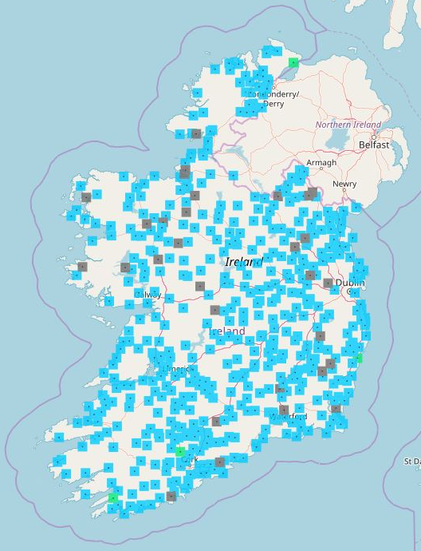

WWTPs in towns/cities with a population equivalent of over 500 during 2006, 2007 and 2008, that were on compliance under The Urban Waste Water Treatment Regulations, 2001 (S.I. No. 254 of 2001) and 2004 (S.I. 440 of 2004)
EPA Unified GIS Application https://gis.epa.ie/EPAMaps/SewageTreatment

Slide 3
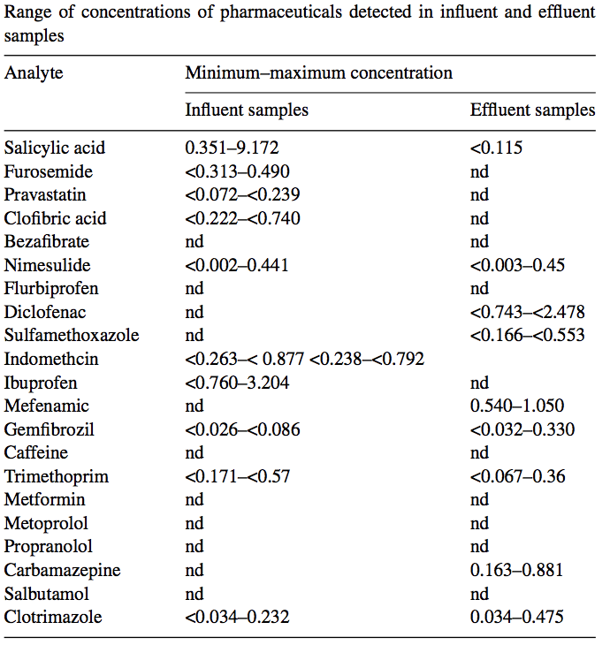
Ireland and CECs – what do we know?
3 WWTPs in the greater Dublin area
WWTP1: PE 60,000, discharge to estuary
WWTP2: PE 90,000, discharge to river
WWTP3: PE 1.7 million, discharge to bay
“the use of antibiotics is one of the most significant threats to long term public health due to the antibiotic resistance explained before”
Irish Pharmacy Union on European Antibiotics Awareness Day, 2017
Lacey, C et al. Sci Talanta (2008) 75:1089

Slide 9
Ireland and CECs – what do we know?
The top 100 most commonly prescribed products in the order of their prescribing frequency
based on General Medical Services (GMS)
Compound name | Rank
 | 2011 | 2016
Diclofenac | 22 | 38
17-Beta-estradiol (E2) | >100 | >100
17-Alpha-ethinylestradiol (EE2) | >100 | 68
Erythromycin | >100 | >100
Clarithromycin | 53 | 55
Azithromycin | >100 | >100
HPRA Annual Report 2017
Statistical Analysis of Claims and Payments 2011;
Health Service Executive Primary Care Reimbursement Service

Slide 10
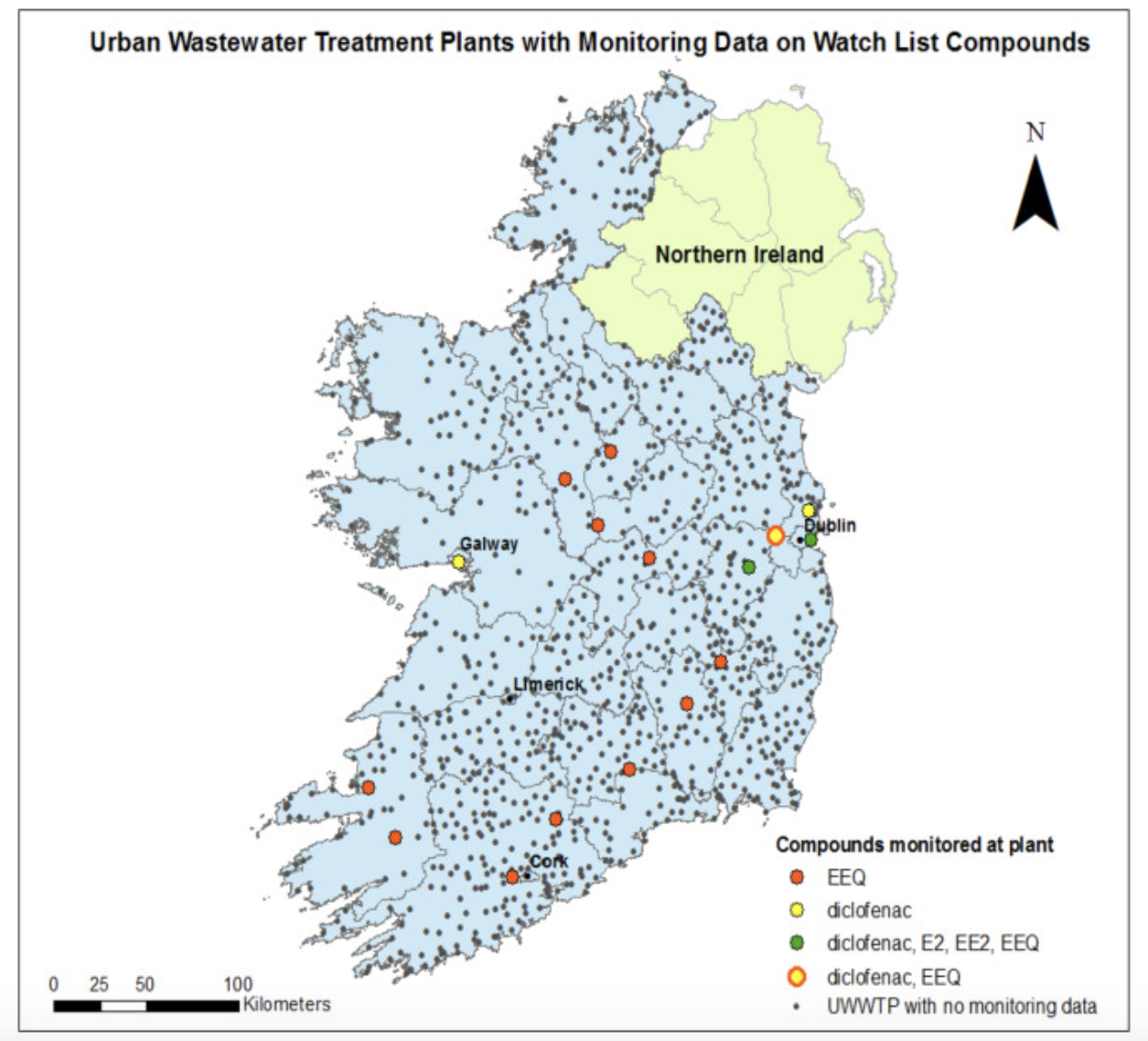
Ireland and CECs – what do we know?
Tahar, A et al. Sci Total Environ (2018) 616-617:187

Slide 11
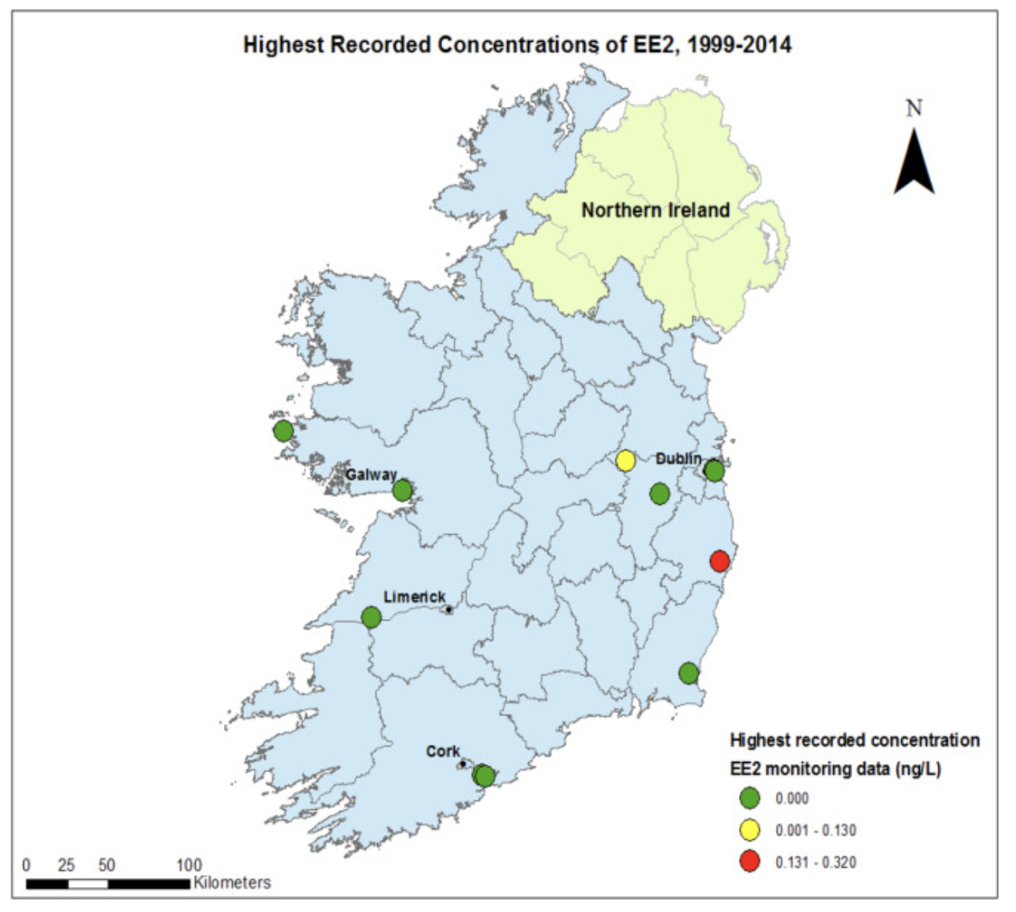
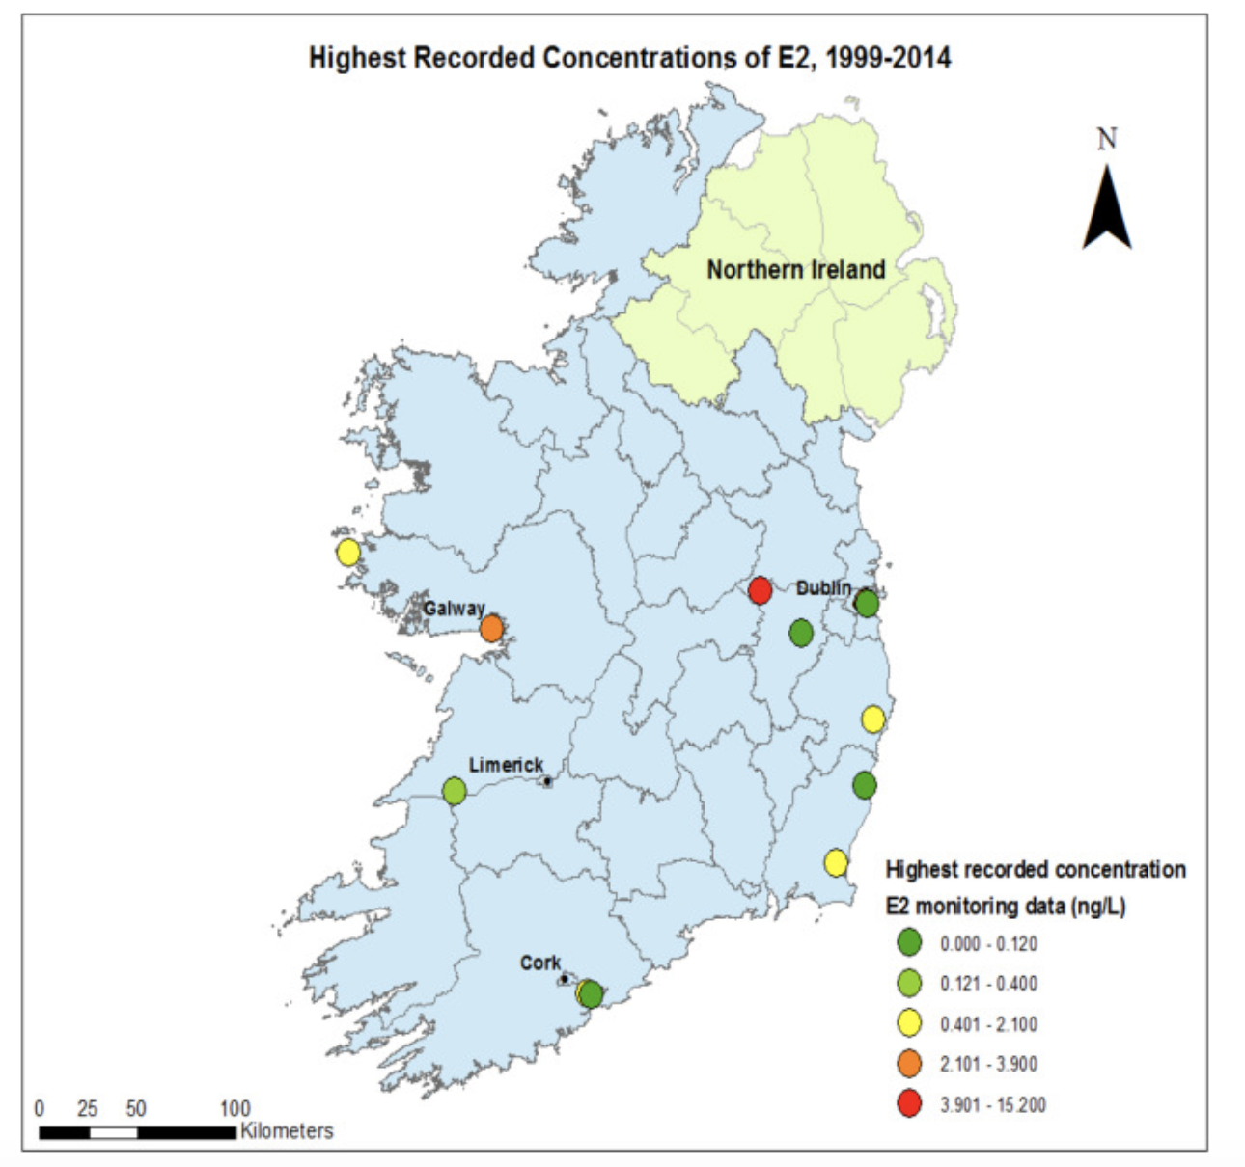
Ireland and CECs – what do we know?
E2 and EE2 have high removal rates as a result of biodegradation or sorption to organic matter
Diclofenac is resistant to conventional wastewater treatment
Tahar, A et al. Sci Total Environ (2018) 616-617:187

Slide 12
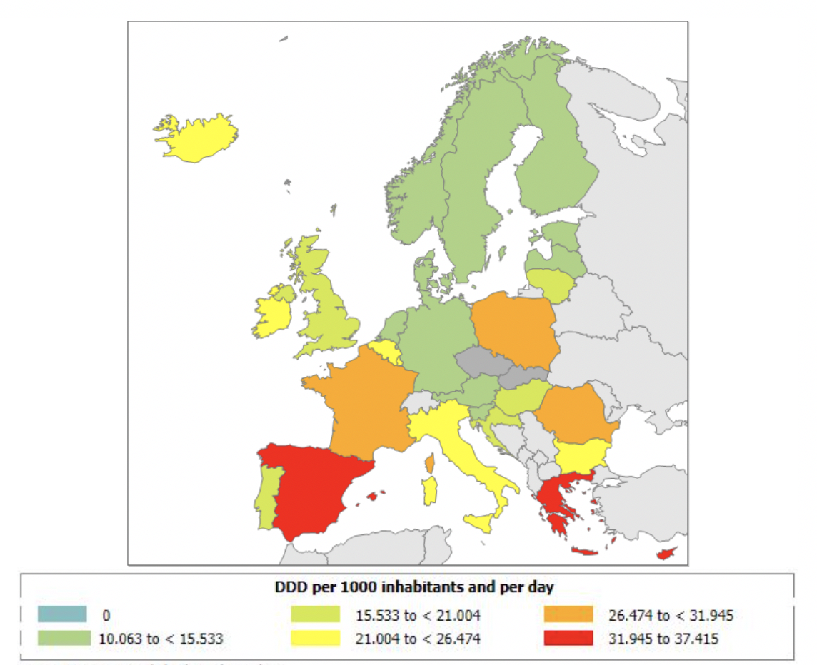
Consumption of Macrolides Antibiotics in the community (primary care sector) 2017
Country overview of antimicrobial consumption
https://ecdc.europa.eu/en/antimicrobial-consumption/database/country-overview

Slide 13
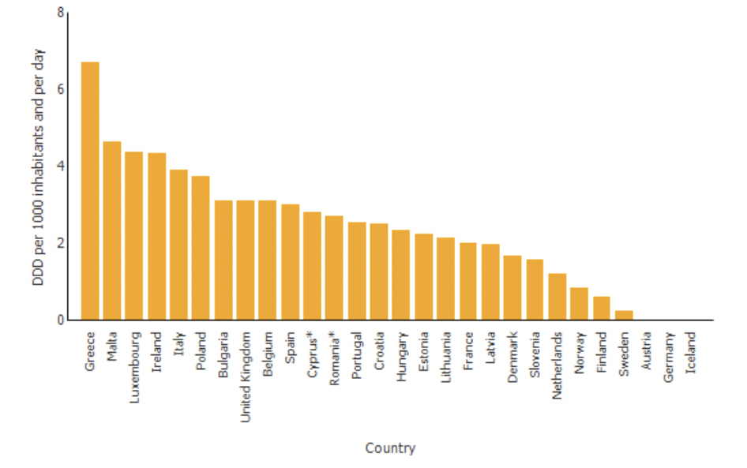
Consumption of Macrolides Antibiotics in the community (primary care sector) and hospital sector in Europe in 2017
Country overview of antimicrobial consumption
https://ecdc.europa.eu/en/antimicrobial-consumption/database/country-overview

Slide 14
2011-2013 study
Pesticide | Internal standard | Priority pollutant
Alachlor | Alachlor-D13 | ✓
Atrazine | Atrazine-D5 | ✓
Chlorfenvinphos | Chlorfenvinphos-D10 | ✓
Chlorpyrifos | Chlorpyrifos-D10 | ✓
Di-2-ethylhexyl-phthalate | DEHP-D4 | ✓
Diuron | Diuron-D6 | ✓
Epoxiconazole | -
Isoproturon | - | ✓
Fenitrothion | Fenitrothion-D6
Malathion | Malathion-D6
Mecoprop | Mecoprop-D3
Octylphenol | - | ✓
Nonylphenol | Nonylphenol-D8 | ✓
Pentachlorphenol | Pentachlorphenol-13C6 | ✓
Pirimiphos-methyl | Pirimiphos-methyl-D6
Simazine | Simazine-D10
Thiram | Thiram-D12
Trifluralin | Trifluralin-D14 | ✓
Glyphosate | Glyphosate -13C2 15N

Slide 16
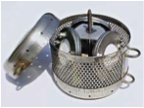
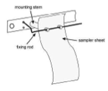
Overview of sites selected in 2013-2015 study

Slide 17
Cork POCIS and water estrogens
Upstream
Downstream
 | Matrix |  | Lough Allua Inchigeelagh | Iniscarra | Shandon | Lough Mahon | Cork Outer Harbour
Analyte |  | Units | 2013
EE2 | POCIS | ng L⁻¹ | <0.2 | 1.39 | <0.2 | <0.2 | <0.2
E2 |  | ng L⁻¹ | <0.5 | <0.5 | <0.5 | 2.36 | 1.98
EE2 | Water | ng L⁻¹* | nd | nd | nd | nd | nd
E2 |  | ng L⁻¹* | nd | nd | nd | nd | nd
Analyte |  | Units | 2014
E1 | POCIS | ng L⁻¹ | < 0.51 | 0.24 | 0.37 | 0.48 | 0.37
EE2 |  | ng L⁻¹ | < 0.12 | < 0.04 | < 0.04 | < 0.04 | 0.07
E2 |  | ng L⁻¹ | < 0.13 | < 0.04 | < 0.04 | 0.06 | 0.09
E1 | Water | ng L⁻¹* | nd | 0.41 | nd | 0.41 | 0.54
EE2 |  | ng L⁻¹* | nd | nd | nd | nd | nd
E2 |  | ng L⁻¹* | nd | nd | nd | nd | nd
*LOD water samples by LC-MS/MS: E1: 0.07 ng L⁻¹ E2: 0.07 ng L⁻¹, EE2, 0.11 ng L⁻¹. 5 L sample n = 2
Effective sampling rates POCIS (ng/sampler/day)*: E1: 0.39, E2: 0.46, EE2: 0.235
Notes:
----- Meeting Notes (21/10/2014 11:39) -----
etienne vermeirssen sampling rates - compare

Slide 18
Dublin POCIS/water estrogens
Upstream
Downstream
 | Matrix |  | Kilcullen | Osberstown | Lucan | Poolbeg
Analyte |  | Units | 2014
E1 |  | ng L⁻¹ | <0.23 | 0.29 | 0.37
E2 | POCIS | ng L⁻¹ | <0.06 | <0.06 | <0.06
EE2 |  | ng L⁻¹ | <0.06 | <0.06 | <0.06
E1 |  | ng L⁻¹* | <0.07 |  | 0.33 | 1.92
E2 | Water | ng L⁻¹* | nd | 0.33 | 0.43 | 0.23
EE2 |  | ng L⁻¹* | nd | nd | nd | nd
Analyte |  | Units | 2015
E1 | POCIS | ng L⁻¹ | <0.23 | 0.31 | 0.42 | 0.41
E2 |  | ng L⁻¹ | <0.06 | <0.06 | 0.06 | 0.07
EE2 |  | ng L⁻¹ | <0.06 | <0.06 | <0.06 | <0.06
*LOD water samples by LC-MS/MS: E1: 0.07 ng L⁻¹ E2: 0.07 ng L⁻¹, EE2, 0.11 ng L⁻¹. 5 L sample n = 2
Effective sampling rates POCIS (ng/sampler/day)*: E1: 0.39, E2: 0.46, EE2: 0.235

Slide 19
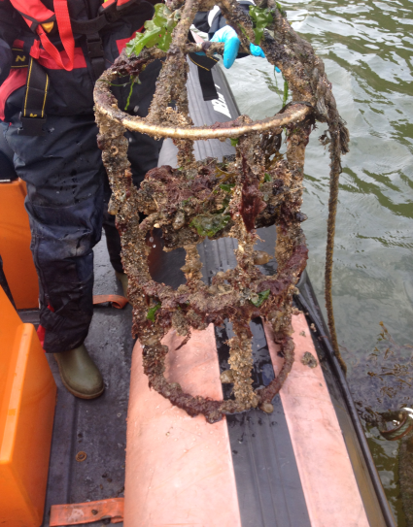
Dublin Bay PAHs

Slide 20
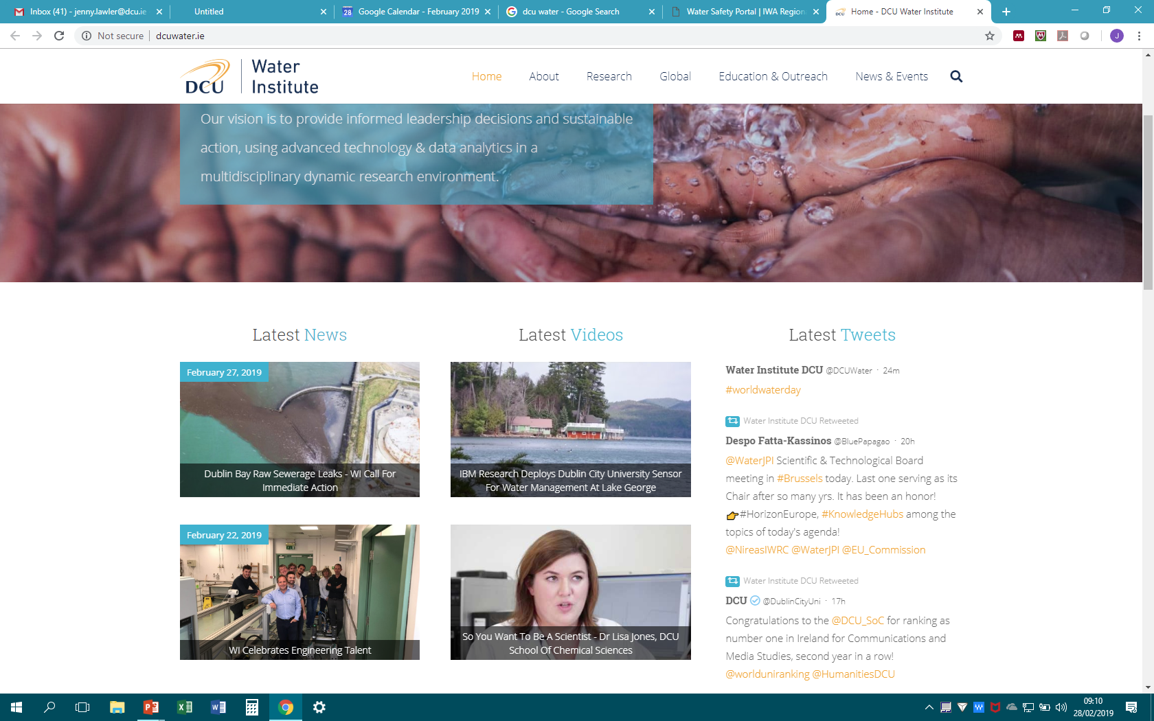
Current CEC Research at DCU Water Institute
IMPACT
Phthalates
Passive Sampling
PROTECTS
EMPIRE

Slide 21





The Role of Passive Sampling in screening and monitoring of new and emerging chemicals
DCU P.I. Fiona Regan
This project demonstrated the use of passive sampling technology (PDMS and POCIS) combined with biota monitoring to assess the presence of priority substances in Irish surface waters. The project focuses in particular on new pollutants earmarked as candidates for the Annex X priority substances list under the EU Water Framework Directive e.g. E2 and EE2, pharmaceuticals, pesticides, PFOS etc.

Slide 22


Potential Sources and Environmental Fates of Certain Phthalates
DCU P.I. Jenny Lawler, Fiona Regan, Anthony Staines
Plasticisers; reprotoxic, endocrine disrupting compounds, ubiquitous
11 phthalates under investigation
  4 newly restricted under REACH from July 2020 (DEHP, BBP, DBP, DIBP, <0.1% by weight in consumer/indoor items)
  Existing restriction on DINP, DIDP, DNOP in toys/childcare items
Surface water, soil, municipal waste, landfill leachate, WWTPs
Wastewater based epidemiology

Slide 23
Irish Situation
Very limited data on occurrence of phthalates in the Irish environment
DBP, DEHP, DINP and DIDP assessed for a variety of solid matrices including sediments, sludges and leachate soils
Matrix | Max. Phthalate Level
River Sediment | 24.4 mg kg⁻¹
Leachate Sediment | 49.8 mg kg⁻¹
Sludge | 174 mg kg⁻¹
Surface Waters | 0.77–92.84 μg L⁻¹

Slide 24




IMPACT – Innovative monitoring to prioritise contaminants of emerging concern for Ireland
DCU P.I. Blánaid White, Fiona Regan
Objectives: detect, monitor and risk assess CECs, in particular pesticides, low level pharmaceuticals and personal care and cosmetic products (PCCPs).
Will provide detailed insight into the occurrence, fate and impact of CECs in Irish receiving waters, establishing a prioritised list of contaminants of emerging concern in Ireland along with a framework to risk assess these compounds, enabling future policy development to protect and enhance our water quality.

Slide 25
IMPACT Key Objectives
Prepare a comprehensive desk study on contaminants of emerging concern (CECs);
to use cutting edge analytical techniques to analyse influent, effluent and receiving waters at Ireland’s urban waste water treatment plants, based on water samples collected over a 2 year period in a catchment with both urban and rural influences;.
to screen collected samples using qualitative LC-HRMS for any other potential contaminants of emerging concern using advanced in silico HRMS data mining and retention time prediction;
to develop a prioritised list of pesticides, pharmaceuticals and PCCPs for Ireland.
Sample sites:
WWTP1: PE 50,000-100,0000
WWTP2: PE <2,000

Slide 26
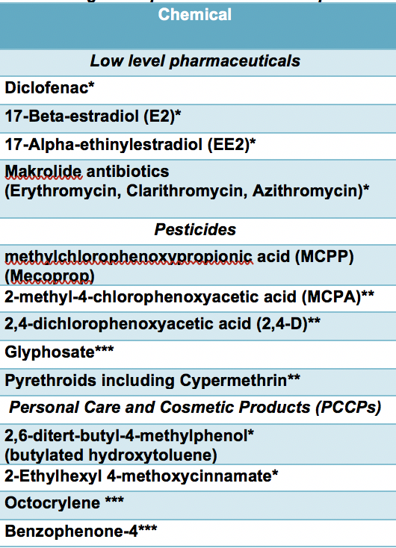
IMPACT - Innovative monitoring to prioritise contaminants of emerging concern for Ireland
A prioritized list of CECs for Ireland
Pesticides
Insecticides
Predictive screening tool for CECs
DCU
Innovative Sampling
TCD
Herbicides
KCL
Antibiotics
Preservatives
Assessment of pesticides, pharmaceuticals, PCCPs in wastewaters
CSIC
Anti- inflammatories
UV filters
Sample Analysis
Hormones
Suncreams
Contaminants of Emerging Concern (CECs)
Comparative assessment of contaminants in UK and Spanish wastewaters

Slide 28
Ecotoxicological Studies
Completed pilot ecotox experiments investigating the individual and combined effects of Cypermethrin and temperature on shredding invertebrates

Slide 29

Project Team:
Dr. Blánaid White (DCU),
Prof. Fiona Regan (DCU)
Dr. Leon Barron (KCL)
Prof. Damia Barcelo (CSIC)
Dr. Jeremy Piggott (TCD)
PhD students - Ms. Imogen Hands,
Ms. Helena Rapp Wright
Postdoctoral researcher – TBA

Slide 30
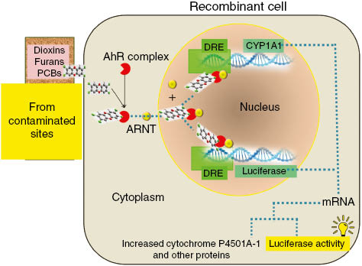
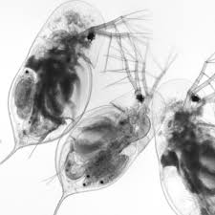
EMPIRE: Effect based biomonitoring for pharmaceutical pollution in Ireland
DCU P.I. Jenny Lawler, Fiona Regan, Blánaid White, Linda Holland
This project will provide the first comprehensive investigation into the applicability of effect based biomonitoring (EBM) for pharmaceutical pollutants, comprising in vivo and in vitro bioassays to assess the quality of Irish surface waters.
Pharmaceuticals

Slide 31
EMPIRE: Key Objectives
Complete a desk based study on life cycle assessment of pharmaceuticals in Ireland
validate analytical methods and bioassays suitable for examination of environmental surface water samples
establish a freshwater mesocosm
identify novel pathways of exposure to pharmaceutical mixtures in freshwater invertebrates
test a suite of bioassays on surface water and validate with chemical analysis.

Slide 32




Protects – Protecting terrestrial ecosystems through sustainable pesticide use
DCU P.I. Blánaid White
The PROTECTS (Protecting Ecosystem Services Through Sustainable Pesticide Use) projectwill provide baseline information in an Irish context to build towards mitigating the effects of pesticide use on terrestrial ecosystem services, focussing on pollinators and soils. We will survey pesticide residues in soils and nectar, investigate the potential hazards of pesticide use for bees, and provide recommendations for a soil monitoring programme and how to mitigate any effects on ecosystem services.

Slide 33
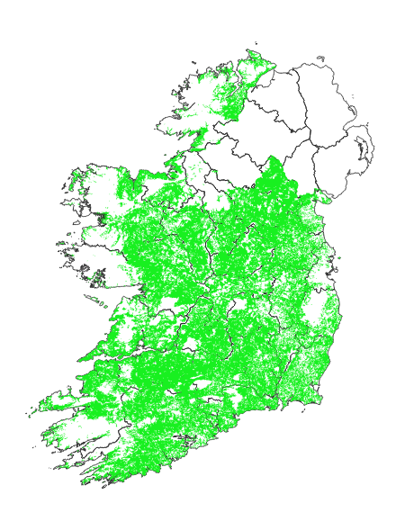
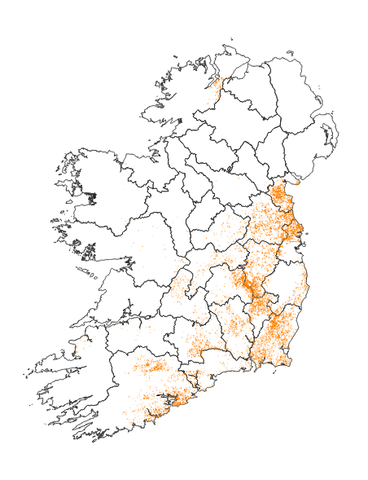
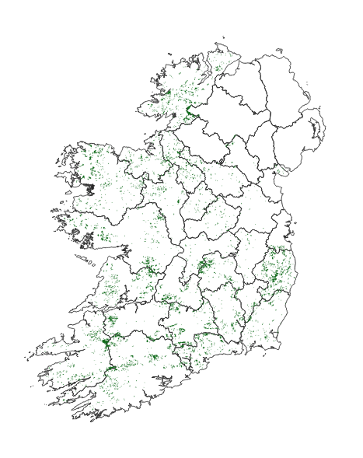
Protects – Protecting terrestrial ecosystems through sustainable pesticide use

Slide 34
Is there an impact to the aquatic environment from WWTP sludge?
Sewage sludge reuse and disposal routes measured in tonnes of dry solids
Year | Agriculture | Compost | Landfill | Other ª | Total
2014 | 42,483 | 9,266 | 361 | 1,433 | 53,543
2015 | 46,697 | 10,946 | 94 | 650 | 58,387
2016 | 45,344 | 9,610 | 102 | 962 | 56,018
2017 | 46,487 | 10,065 | 87 | 2,134 | 58,773
ª Use of sludge in anaerobic digestion, cement production and in storage awaiting land spreading.

Slide 35


2020 Meeting of the Society of Environmental Toxicology and Chemistry (SETAC) – Dublin.
  May 2020, Dublin Convention Centre
  >2000 participants participants in academia, industry and regulatory agencies
  >60 countries
  Special session contaminants of emerging concern
  IMPACT project : J Piggott (Local Organizing Committee Chair)

